Slide 1

Respiratory care of patients in Rehab for nursing

Slide 2
objectives
By the end of this class you should be able to:
  Identify different supplemental oxygen delivery devices
  Identify parts of tracheostomy
  Identify passy muir valve and proper procedure for caring for patient with PMV trial
  State the differences in CPAP and BiPAP
  Perform oral care on patients with continuous BiPAP

Slide 3
Basic oxygen administration
Ensure that the patient is really requiring oxygen therapy. Make sure that pulse ox reading is accurate. If a patient is requiring oxygen therapy, and is not in obvious distress, start with nasal cannula if appropriate. Anything under 4 liters per minute does not need humidification. Oxygen is a medication and an order must be placed.
Bs

Slide 4
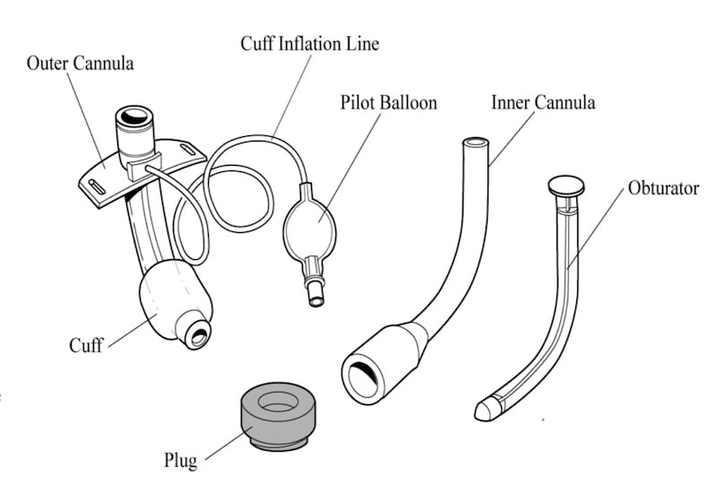
Tracheostomies
This Photo by Unknown author is licensed under CC BY-NC-ND.

Slide 5
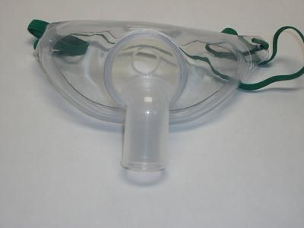
Oxygenating through a trach
Usually, in the rehab setting, you will be using a trach collar
Trach collars are the mask-like appliance that goes over the trach

Slide 6
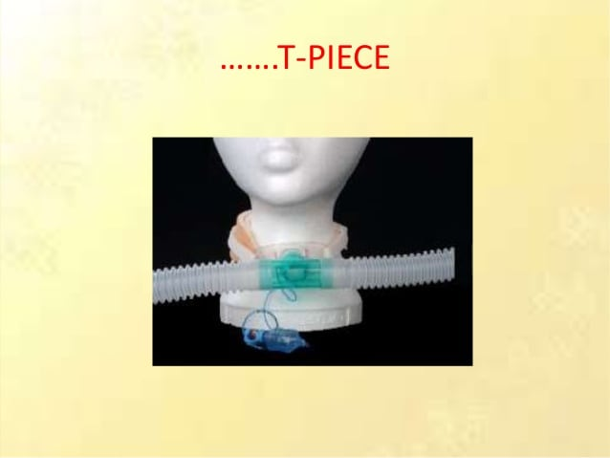
T-bar or T-piece oxygenating system

Slide 7
T-piece vs trach collar
The benefits of the t-piece compared to trach collar are:
  Research has shown that the patient receives more benefits from nebulized treatments through t-piece compared to trach collar
  In-line suction can be attached and reduce the chances of infection with frequent tracheal suctioning

Slide 8
Passy Muir valves
What is a Passy Muir valve? It is a one way valve that allows a patient to speak. Air flows in but does not flow out of the valve, but instead around the trach.
Cuffed trachs must be deflated before application of valve to allow outflow of air from nose and mouth. If cuff is not deflated YOU WILL SUFFOCATE THE PATIENT
Tolerance and a change in breathing may be something that patients have to adjust to so you must monitor patient tolerance
Remain with patient while they are doing PMV trial

Slide 9
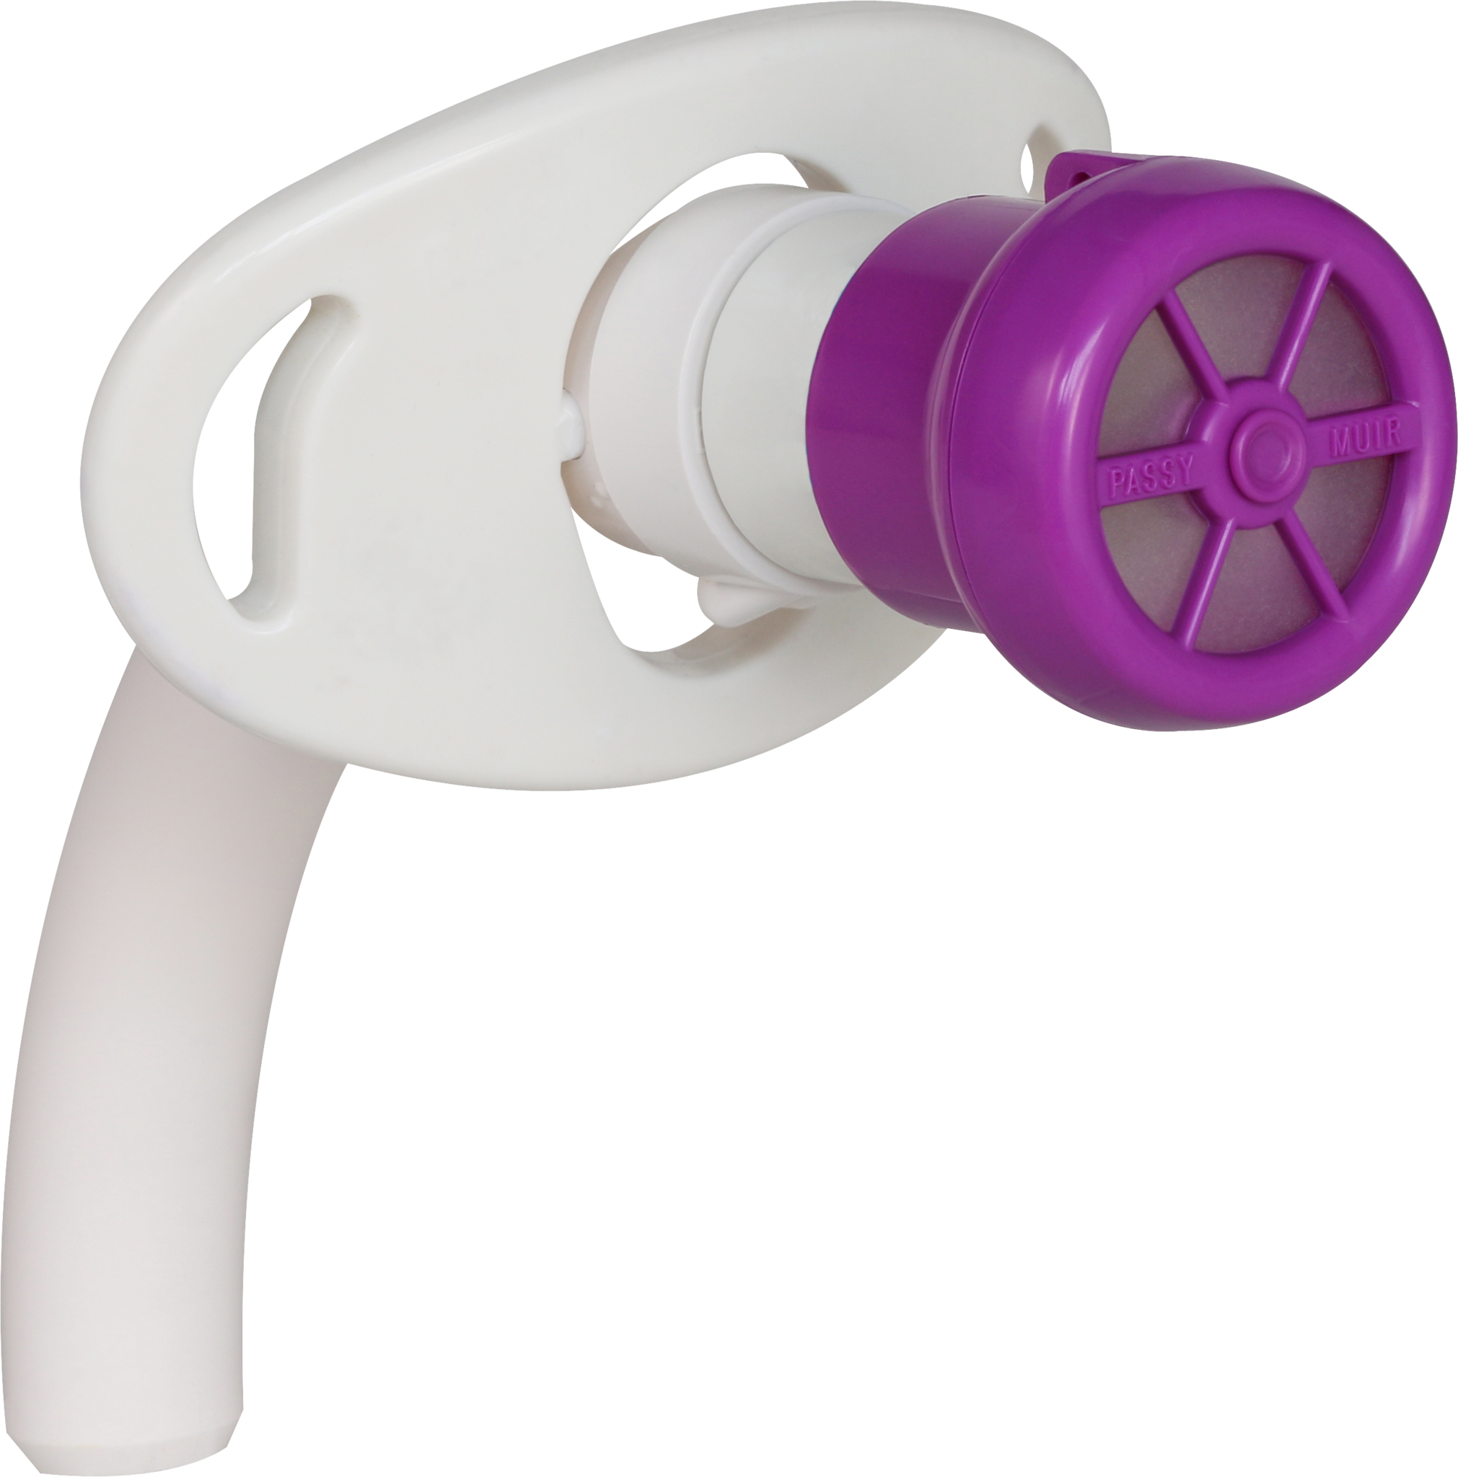
Passy Muir valves

Slide 10
Suctioning: EVERYONE'S responsibility
Maintaining airway patency does not solely fall on RT. It is a basic nursing skill everyone learns in nursing school.
Make sure you are assessing your patient's airway, breath sounds, and ability to clear secretions at least once a shift and PRN. If a patient is complaining of difficulty breathing, assess the patient and then call RT so you can deliver more information so that they can be prepared to help you appropriately.
When assessing, make sure you have accurate vitals signs including a pulse ox reading with a heart rate that correlates to pulse

Slide 11
Suctioning: EVERYONE'S responsibility
If your patient requires frequent suctioning, strategize with your RT the best way to accomplish this. Monitor continuous pulse-ox while performing
NT suctioning is absolutely a nursing responsibility and should be performed as needed for those patients that cannot effectively clear their secretions
Supplies for NT suctioning: Ohio unit (vacuum), suction tubing, flexible suction catheter, and possibly saline to clear line if secretions are thick

Slide 12
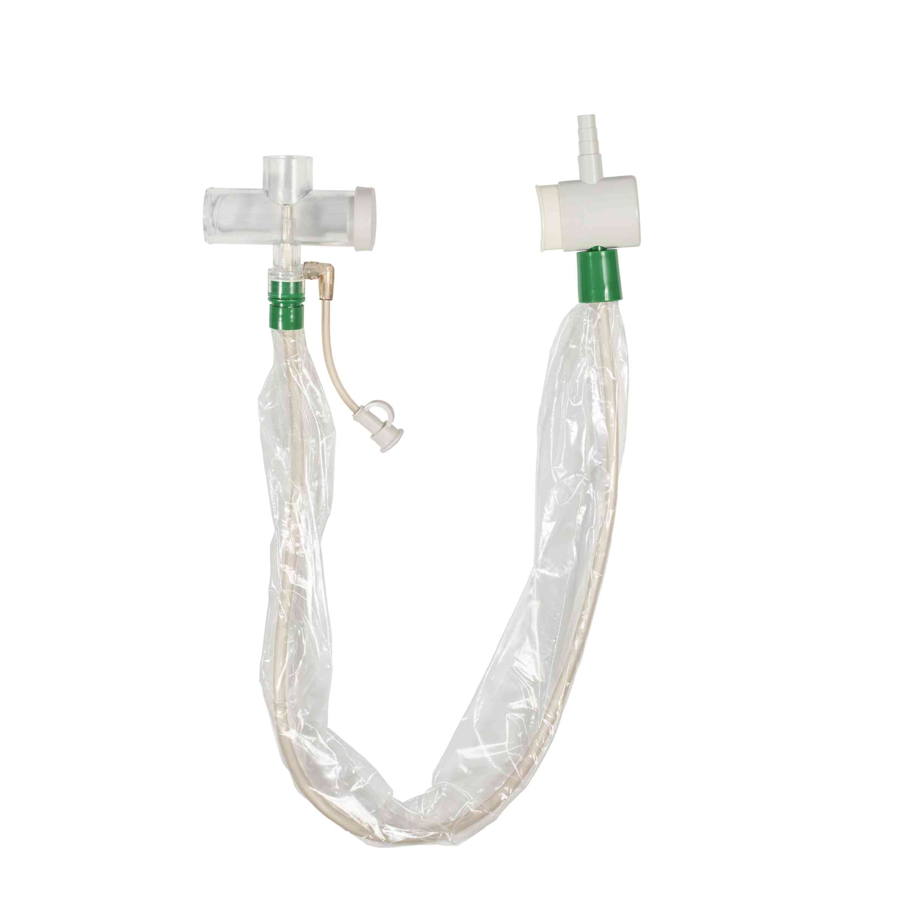
Suctioning with in-line (Ballard) and t-piece
It is ideal to have continuous pulse oximetry during procedure to monitor desaturation so you can ensure the patient is tolerating suctioning
The inline suction will be set up by RT. In-line or Ballard stays connected to t-piece and plastic sheath keeps suction catheter sterile.

Slide 13
Tracheal suctioning without a Ballard
This is a sterile procedure, so sterility maintenance is of the utmost importance
Supplies for tracheal suctioning should include sterile saline, sterile suction catheter, sterile gloves
Do not make more than 2 passes with the same catheter
When suctioning is completed, discard used supplies. Do not reuse catheter

Slide 14
Trach care
Trach care is also a shared responsibility
If your patient has a soiled trach dressing, it is your duty and responsibility to clean trach to prevent infection
Trach care is a sterile procedure
Trach care kits are available and include sterile water, gloves, pipe cleaners, and gauze. Peroxide should be used inn sterile tray to clean inner cannula
Kits are not to only be used twice (only once if there is odorous, colored secretions)
RT will check you off on trach care

Slide 15
Suctioning and trach care: documentation
Document.......
  Color
  Odor
  Amount
  Consistency
  How the patient tolerated the procedure

Slide 16
CPAP and BiPAP
What is the difference?
  CPAP: continuous positive airway pressure; gold standard for OSA (obstructrive sleep apnea)
    Usual mode of oxygen delivery for home use in sleep apnea patients (they may have their own machine)
    BiPAP: Bilevel positive airway pressure; used in the hospital; external non-invasive ventilation; can be used for OSA, opiate use that results in shallow breathing, stroke, centralized sleep apnea
    The difference is the continuous airway pressure. BiPAPs allow for inspiratory and expiratory pressures to be set. Some patients do not tolerate continuous pressure. BiPAPs can have more options for sensitivities, timings, and triggers than CPAPs

Slide 17
Application, fit, and leaking BiPAP masks
RT will show you where to check for a leak
Some patients may feel claustrophobic with certain masks so nasal pillows or a "fireman's mask" may be provided to increase compliance. Check with RT to see what masks may be available.
Applying and selecting the right size of mask is the RTs expertise. Once they have selected the appropriate mask, the nurse's responsibility is to ensure that the mask maintains its seal and patient comfort as well as protecting the bridge of the nose from skin breakdown.
RT will check you off on application of BiPAP masks and show where to look for pressure settings and tidal volumes (the amount of air the patient is breathing)

Slide 18
Oral care during BiPAP usage
It is imperative that proper oral care be done periodically with patients on continuous BiPAP.
If they awaken during the night, temporarily remove mask and offer hydration and oral care. Ensure that mouth is clear before replacing BiPAP on patient
In rare instances when patient is wearing BiPAP during the day in rehab, make sure that you are offering meals and oral care as indicated and tolerated

Slide 19
Nebulizer treatments
If a patient is needing neb treatments, you may administer the treatment if RT is unavailable
Our focus should always be patient centered
Neb treatments are a billable service so make sure that you are documenting in the RT flowsheet the treatment accordingly if you are the one delivering it

Slide 20
Conclusion
We are team, we need to provide care with teamwork
Recently, our RTs have been very busy with the extremely ill patients in CCU and have duties beyond respiratory therapy
Suctioning, pulmonary toileting, and nebulizer treatments are within the scope of your nursing practice

