Slide 1
Antimicrobial Stewardship (AMS)

Slide 2


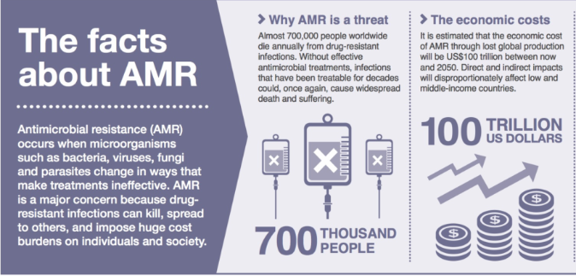
Antimicrobial Stewardship in Nursing
What is the goal of the EPCH Antimicrobial Stewardship (AMS) initiative?
EPCH AMS initiative serves to improve patient outcomes and promote patient safety through the evaluation of appropriate antibiotic selection, dosing, and duration of therapy.
EPCH will implement antibiotic safety measures in order to help reduce the incidence of antimicrobial resistance.

Slide 3
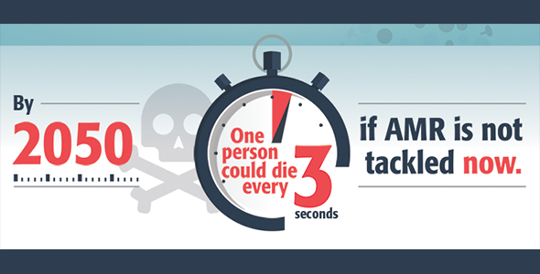
AMS Adherence Importance
Non-adherence threatens effective prevention and treatment how?
Simple infections like bacterial food poising, minor cuts or surgical incisions will become lethal.
The effective antibiotics that we use today will no longer be effective tomorrow.
Each year in the U.S., at least 2.8 million people get an antibiotic-resistant infection, and more than 35,000 people die. (CDC)
WE WILL RUN OUT OF ANTIBIOTIC TREATMENT OPTIONS IF WE ARE NOT TAKING PRECAUTIONS!

Slide 4
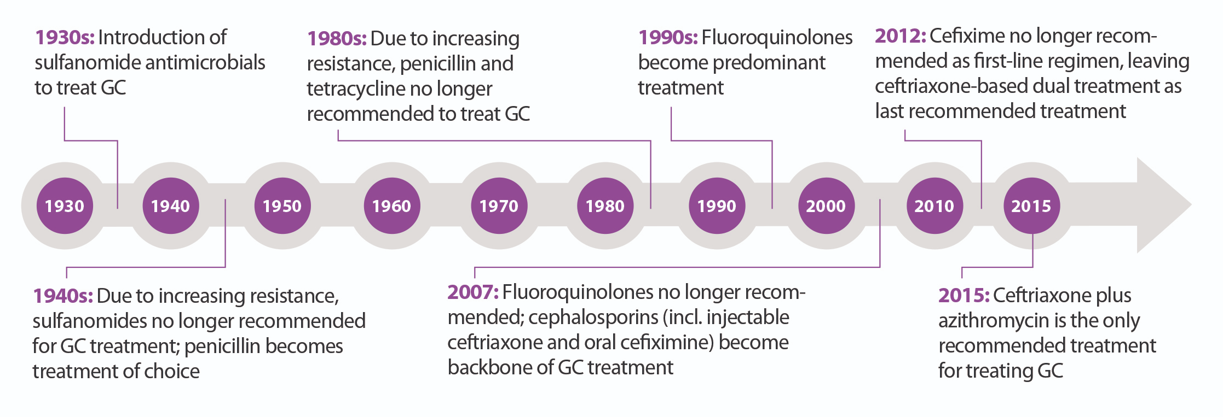
AMS Adherence Importance
Timeline of Antibiotic Resistance

Slide 5


AMS Evaluation of Antibiotic Therapy
Evaluate patients to see:
If they need to be on antibiotics:
Are the antibiotics ordered appropriate for the given indication?
Review sensitivity of culture to ensure that antibiotic ordered is appropriate.
Have cultures been drawn before administering the first dose of antibiotic?
Has the physician been notified of the sensitivities?

Slide 6
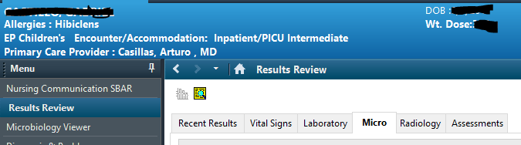
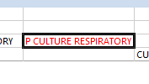
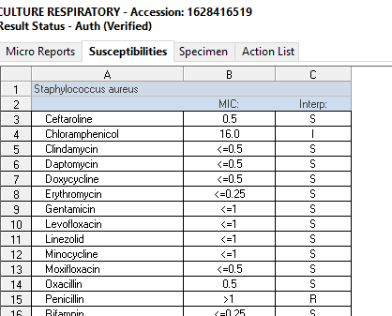
Reviewing Sensitivity Report
Step One: Go to results review and select “Micro Tab”
Step Two: RIGHT CLICK on the culture you want to view and select “View Details”
Step Three: Review “Susceptibilities Tab” to organism is susceptible “S” to the antibiotic ordered.

Slide 7



AMS Evaluation of Antibiotic Therapy & Allergies
Nurses can reduce the risks associated with administration of inappropriate antibiotics by confirming, documenting, and updating the allergy status of patients.
Assess to see if your patient has any active allergies and ensure any allergies are documented in the patient’s profile.
Speak with the pharmacist or physician if you see an interaction between your patient’s allergy and any antibiotic that is ordered (i.e patient has penicillin allergy and piperacillin/tazobactam or a cephalosporin is ordered).

Slide 8
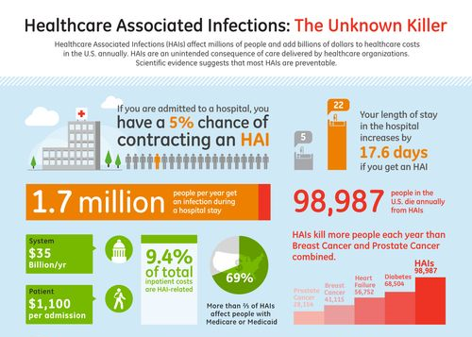
Key Reminder
Nurses are the primary bedside patient advocate and a key player in monitoring for healthcare-associated infections. These routine nursing functions represent applications of AMS principles in daily patient care.
Healthcare Associated Infection
Administration of antibiotics to treat infection
Increased risk of antibiotic resistance

Slide 9


AMS Reconciling Antibiotics at Patient Care Transitions
Evaluate if there is a need for antibiotic therapy when your patient is transferred to your unit to help reduce inappropriate antibiotic use.
Assess to see how long your patient has been on antibiotics and make sure to report this information to the receiving team.
Antibiotics should always have a STOP time when ordered. Confirm there is a stop time and that it is aligned with prescribing recommendations in Lexi-Comp.

Slide 10



AMS Timing of Antibiotic Administration
Are patients receiving antibiotics promptly at scheduled times of administration?
Antibiotics are considered time critical and should be administered +/- 30 minutes of time scheduled. Timely administration of antibiotics is associated with better patient outcomes and survival. If multiple medications including antibiotics are due at the same time, contact the pharmacist to assist in retiming doses.

Slide 11
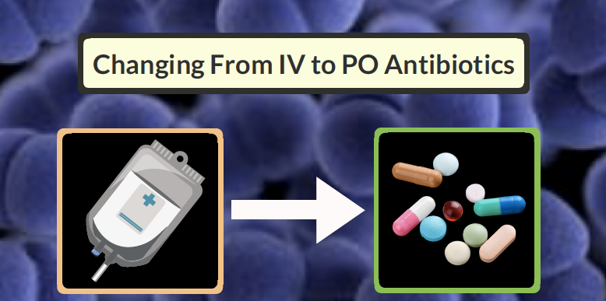
AMS Antibiotic IV to PO Conversion
If your patient is tolerating PO medications, have you contacted the physician to see if the patient can be switched from IV to oral antibiotics?
This can improve patient safety by reducing the need for IV access.
Decrease risk of IV infiltrate or central line infection.

Slide 12
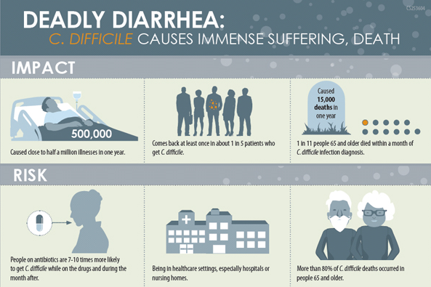

AMS Antibiotic Duration of Therapy
Prolonged duration of antimicrobial treatment is a risk factor for development of Clostridium dificile and antimicrobial resistance.
If your patient is on antibiotics, engage with physicians to inquire about intended duration of antibiotics.

Slide 13


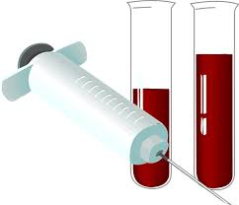
AMS Therapeutic Drug Monitoring
Assess to see if patients are on any antibiotics that require drug monitoring such as vancomycin or gentamicin that require peaks and/or trough levels.
If they are on these antibiotics, does the patient have an appropriate trough level ordered at the correct time?
If trough level is due:
Do not to administer subsequent dose until trough results are drawn as this will skew results.
Trough should not be drawn from the line that is being used to administer antibiotic as this may also skew results.
If trough level is over-therapeutic investigate to see if trough was drawn at appropriate time or while antibiotic was infusing while lab was being drawn.
If trough was drawn correctly and lab value is accurately high, hold subsequent dose and contact the physician or pharmacist to ensure appropriate dose adjustments are made.

Slide 14

AMS Restricted Antibiotic Categories
Category 1 Restricted- Infectious Disease MD approval and consult needed prior to dispensing:
Ceftaroline (Teflaro) Ceftazidime-avibactam (Avycaz) Ceftolozane-tazobactam (Zerbaxa)
Dalbavancin (Dalvance) Isovuconazonium sulfate (Cresemba) Posaconazole (Noxafil)
Category 2 Restricted -Infectious Disease MD approval and consult or P&T Chair’s approval needed within 12 hours of ordering:
1st dose will be dispensed
HEME/ONC exception: Pharmacy review and oversight
Pharmacy may request ID consult
Amphotericin B Liposomal (and conventional) Daptomycin (Cubicin) Ertapenem (Invanz)
Imipenem/cilastatin (Primaxin) Linezolid (Zyvox) Meropenem (Merrem)
Sulfamethoxazole/trimethoprim (IV) Voriconazole (Vfend)

Slide 15


AMS Restricted Antibiotic Categories
Category 3 Pharmacy review is needed within the first 72 hours for medication to be dispensed, post 72 hours approval is required by ONE of the following before it will be dispensed:
Clinical Pharmacist
ID approval
P&T Chair
Aztreonam (Azactam) Cefepime (Maxipime) Micafungin (Mycamine)
Vancomycin (Vancocin)
Category 4 Unrestricted but pharmacy is tracking and monitoring
Aminoglycosides Amikacin Gentamicin Tobramycin
Category 5 Unavailable and will not be dispensed
Delafloxacin (Baxdela) Oritavancin (Orbactiv) Tedizolid (Sivextro)
Tigecycline (Tygacil)

Slide 16


AMS Adherence to Current EPCH Infection Control
Are you following appropriate gloving and handwashing between patient contacts?
Are you ensuring correct isolation precautions are used when needed?
Are you ensuring that all healthcare personnel are following these precautions? (i.e. physicians gowning up to go into contact precaution rooms, foaming in/out of patient rooms, etc.)

Slide 17

AMS Adherence to Current EPCH Infection Control
Recommend appropriate vaccinations to patients depending on their age and health history.
Promote good hygiene by recommending hand washing, safer sex, and covering nose & mouth when sneezing.
Emphasize to diabetic patients importance of glucose management to avoid unnecessary infections.
Provide patient education about antibiotics especially prior to discharge.
All these efforts will help reduce the likelihood of infection and in turn decrease the number of antibiotics being used.

Slide 18

AMS Adherence to Current EPCH Infection Control
The Infectious Diseases Physician Role as part of the
AMS Program includes:
Provide a leadership role and collaborate with physicians.
Works with pharmacy to establish a routine for daily patient review.
Serves as advocate/champion of the program; makes an important contribution to formulary decision making and antimicrobial restriction policies.
Provide feedback to Medical Staff to gain acceptance of the program.
Provides legitimacy to the AMS Program and ensure team’s goals are understood and met.

Slide 19

AMS Adherence to Current EPCH Infection Control
The Pharmacist Role as part of the AMS Program includes:
Promoting optimal use of antimicrobial agents.
Provides daily feedback and recommendations to practitioners for appropriate antimicrobials use.
Participating in efforts to reduce antibiotic resistance by following institutional formulary and local microbiology resistance patterns to improve antimicrobial use.
Providing education on antimicrobial stewardship to health professionals and patients.

Slide 20


