Slide 1

EMTALA Compliance for
ER Clinical and Non-Clinical Staff

Slide 2

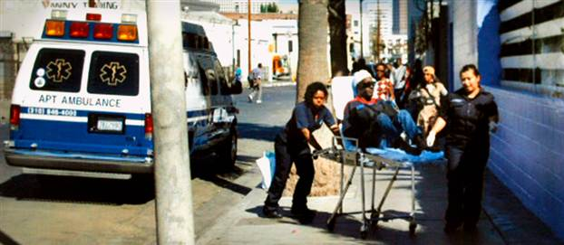
Background
Emergency Medical Treatment and Active Labor Act
EMTALA was enacted by Congress to prevent hospitals from refusing to treat patients or transferring them to charity hospitals or county hospitals because they are unable to pay or are covered by Medicaid.
Bottom Line:
EMTALA applies to ALL emergency patients, whether insured or not

Slide 3
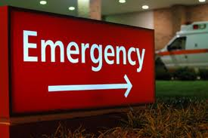
What triggers EPCH’s EMTALA obligations?
Any patient who presents to EPCH and requests emergency services is subject to EMTALA.
ALL Patients that present to EPCH ED must be accounted for on the Central log. Name, Date/Time of Service and Disposition (AMA, Discharge Home, Admit Inpatient, etc…)

Slide 4
What are the age limits for Patients served at EPCH?
EPCH has adopted and implemented the Policy Statement issued by the American Academy of Pediatrics in September 2017.
Patients up to the age of 21 yrs.
  Exceptions could be made when the pediatrician and family agree to an older age, particularly in the case of a child with special health care needs, AND/OR
  Have a previous treatment history with Facility and/or Provider
Considerations when discussing the transition to adult care of the patient should include:
    The needs of the individual patient and the family situation;
    The training, abilities, and interests of the physicians involved
      *Applies to all services provided by EPCH

Slide 5
“Presenting” to EPCH
A patient has “presented” to EPCH when (s)he is on the EPCH campus (all EPCH buildings within 250 yards of EPCH including sidewalks and driveways)
  For example, if a patient parks in the visitor garage with the intention of seeking emergency care from EPCH but is unable to ambulate to the ED entrance, the patient has nonetheless “presented” to us.
  Our proximity to UMC heightens the need for caution in determining whether a patient is presenting to EPCH or UMC. This is determined by the patient.
Emergency medical screening and care also extends to infants and children abandoned at the emergency department by parents or others.

Slide 6
How Does EPCH Meet its EMTALA Obligations?
Step One: Provide Medical Screening Examination
Every patient presenting to EPCH requesting emergency services is entitled to a medical screening exam (MSE) by a qualified medical personnel to determine if an emergency medical condition (EMC) exists.
The medical screening exam must be of sufficient scope to determine the existence of an emergency medical condition.
QUESTIONS RELATING TO FINANCIAL STATUS CANNOT BE ASKED BEFORE THE MSE!
Triage is NOT considered a MSE.

Slide 7
How Does EPCH Meet its EMTALA Obligations?
Step Two: Determine if an Emergency Medical Condition Exists
Emergency Medical Condition: A condition manifesting itself by acute symptoms of sufficient severity (including severe pain) such that the absence of immediate medical attention could reasonably be expected to result in placing the individual's health [or the health of an unborn child] in serious jeopardy, serious impairment to bodily functions, or serious dysfunction of bodily organs.

Slide 8
If No Emergency Medical Condition Exists…
When the medical screening examination, using the resources of the hospital in a manner consistent with all similar patients and regardless of payer, reveals no EMC:
  EPCH’s “obligations” under EMTALA cease and the patient may be transferred to another hospital or level of care, or discharged.

Slide 9
EPCH’s EMTALA Obligations if Emergency Medical Condition is Diagnosed
Step Three: Stabilize/Transfer/Admit
(1) Stabilize and/or Transfer
When the MSE reveals the existence of an Emergency Medical Condition, our obligations are as follows:
  We must provide stabilizing treatment within the capabilities and resources of the hospital.
  We may transfer the patient if the benefits outweigh the risks.
    For women in labor, the emergency medical condition is defined as existing until the delivery of the baby and placenta, or the certification by a physician or mid-wife of false labor.
  OR…
  (2) Admit
  Patients with EMC admitted in good faith in order to stabilize the EMC = EMTALA obligation met.

Slide 10

How does EMTALA Define Stabilization?
No material deterioration of the condition, within reasonable medical probability, will result from or occur during the transfer of the individual;
Pregnant woman who is having contractions: To deliver the fetus and placenta (or diagnosis of false labor).

Slide 11

What if Stabilizing Treatment is Needed Beyond EPCH’s Resources?
An EMC exists but we do not have the resources to stabilize—next step?
If EPCH does not have the capacity, capability, or resources to provide stabilizing treatment for an EMC, an appropriate transfer must be arranged for the patient to a facility with the capacity, capability and resources to provide stabilizing treatment.
Examples: We may need to transfer a trauma patient; or we may not have an operating room available in the time required; or we may not provide the specialized service (e.g., a burn unit).

Slide 12
What is an Appropriate Transfer?
The Transferring Hospital has provided treatment to the individual with an Emergency Medical Condition within the hospital’s capacity
Receiving Hospital, must accept patient, including identifying an accepting Physician
The Transferring Hospital provides sufficient data, including medical records, x-rays, lab reports as available, to the Receiving Hospital to facilitate continuing evaluation and treatment
The Transferring Physician has certified the transfer and arranged for the use of appropriate mode of transportation, personnel, and equipment.
The judgment of the Transferring Physician will take precedence when determining the existence of an EMC and the appropriateness of the Transfer.

Slide 13

Reporting Inappropriate Transfers
Receiving hospital must report inappropriate transfers (e.g., without approval) to CMS/DSHS
Contact EPCH Compliance Department:
  Cathy Gibson, Chief Compliance Officer:
  (915) 521-7523 or Ext # 80501; CGibson@umcelpaso.org
  Monica Perches, Asst. Compliance Officer:
  (915) 242-8529 or Ext # 80505; Monica.Perches@elpasochildrens.org

Slide 14
What if the Patient/Decision Maker Refuses the Transfer or Requests a Transfer before Completing Stabilizing Treatment?
Under EMTALA a patient/decision maker has the right to
  Request a Transfer to another facility, or
  Refuse Transfer to another facility
The right exists for patients with emergency medical conditions that have not been stabilized
If the request/refusal is made, the request/refusal should be documented in the patient’s medical record or his/her personal representative should sign a form documenting that (s)he understands the risks associated with either
  Transferring without receiving stabilizing treatment, or
  Refusing to transfer to obtain stabilizing treatment.
EPCH Staff should document the event in an RDE by end of shift.

Slide 15
EPCH’s EMTALA OBLIGATIONS AS A RECEIVING HOSPITAL
Accept an appropriate transfer of a patient with an unstabilized EMC who requires specialized capabilities or facilities if EPCH has the capacity to treat the patient
EPCH is required to accept a transfer from a Transferring Hospital if the following exist:
  The patient presented to the Transferring Hospital seeking emergency care and treatment;
  The patient has an emergency medical condition which is not stabilized;
  The Transferring Physician determines that the patient requires further examination and treatment to stabilize the emergency medical condition; and
  EPCH has the capability and capacity to treat the patient.

Slide 16

Use of ED for Non-Emergency Services
If an individual presents to the ED and requests exam or treatment but the nature of the request “makes it clear” that the medical condition is not of an emergent nature, EPCH is still required to perform a screening appropriate for any individual presenting in the ED to determine that the individual does not have an EMC.
Bottom Line:
Requirement to provide MSE on ALL individuals; No exception.

Slide 17

Potential Punishments for EMTALA Violations
Report to DSHS (Mandatory)
Termination of Medicaid/Medicare Agreement
Hospital fine up to $50,000 per patient
Physician fine up to $50,000 per patient
Civil lawsuit for damages
Finding of civil rights violation

Slide 18
EMTALA Rules to Remember
Log in every patient who presents for emergency care: complaint/diagnosis; disposition
Triage patients per protocol to establish the order in which patients receive the Medical Screening Exam
Provide the MSE, following triage, to all patients regardless of acuity who present in the hospital (including moving patients to the ED as necessary to complete the MSE)

Slide 19
EMTALA Rules to Remember
Do NOT delay the MSE or attempt to secure verification or authorization from third-party payor, nor attempt to influence the patient by drawing payer status issues to the patient’s attention before completion of the MSE and initiation of stabilizing care
Provide necessary testing, including on-call services, as needed to exclude the presence of a legally defined emergency medical condition

Slide 20
EMTALA Rules to Remember
To the extent of EPCH’s capabilities, provide stabilization, such that the patient is not likely to deteriorate from or during transport or discharge (in the case of OB patients with contractions present, until stabilized by delivery of baby and placenta) and make a medically appropriate transfer if the patient exceeds EPCH’s capabilities.

Slide 21
EMTALA Rules to Remember
A physician can arrange transfer of EMTALA patients only if services or care are not available at EPCH or upon patient request (documented to EMTALA requirements)
Accept transfers for all ED patients when EPCH is better able to care for the patient who requires a higher level of care than the hospital requesting transfer

Slide 22

EMTALA Rules to Remember
When transferring a patient under EMTALA, obtain and document on the Memorandum of Transfer Form (MOT) the advance acceptance from the receiving hospital, indicating the time and physician’s name.

Slide 23

EMTALA Rules to Remember
When transferring a patient, the Transferring Hospital must provide medically appropriate vehicles, personnel, and life support equipment for all EMTALA transfers.
Private vehicles are not appropriate transfer vehicles.

Slide 24
EMTALA Rules to Remember
The physician initiating a transfer under EMTALA must document on the Memorandum of Transfer (MOT) form a physician certification with clearly stated risks and benefits of transfer for all EMTALA transfers
Transferring Hospital must provide medical records, labs, reports, and consultation records to accompany the patient
  Document on the Memorandum of Transfer Form (MOT)

Slide 25
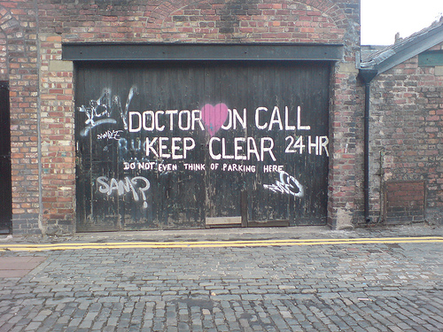
EMTALA Rules to Remember
The Transferring Hospital/Physician must document on the Memorandum of Transfer Form (MOT) the name of any on-call physician who refused to respond or failed to make a timely response of any EMTALA patient transferred as a result of that refusal or lack of timely response.
Bottom Line:
Report any refusal/failure to respond.

Slide 26
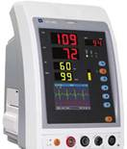
EMTALA Rules to Remember
For each EMTALA patient, obtain and document full vitals including pain assessment on all presenting patients and maintain documented vitals at appropriate frequency during the stay.
Bottom Line:
In ALL CASES obtain and document discharge/transfer vital signs

Slide 27
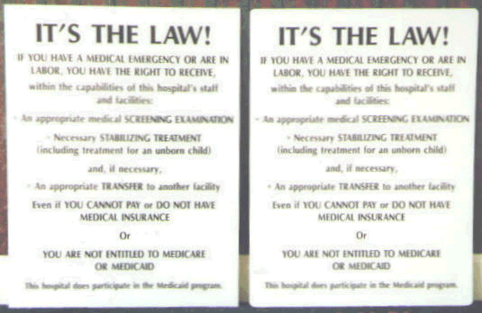
EMTALA Rules to Remember
Post EMTALA signs in the ED and other areas where patients will see them
  Signs that conflict with the intent and purposes of EMTALA may not be posted
  - Signs must be easily read from a distance of 20 feet and must appear in non-English languages common to the patient population (i.e., Spanish)

Slide 28
What if a patient under the age of 18 presents for emergency services without their parent present?
ED personnel will attempt to obtain consent to treat from an appropriate person such as the child’s parent, legal guardian, or local authority responsible for the child.
If unable to obtain consent, the medical provider in charge of the child’s care will determine what is in the best interest of the child.
Consent for treatment of life-threatening conditions may be inferred if there is not enough time to obtain written consent. Examples include a child critically injured and bleeding heavily after being hit by a car, or a child in active labor and close to delivering a baby. Written consent will be obtained as soon as possible afterwards.

Slide 29
References
42 USC Section 1395dd
American College of Emergency Physicians. (2012). EMTALA. Retrieved
9/1/2012 from: http://www.acep.org/content.aspx?id=25936
Taylor, M. Sigma Theta Tau International. Will a child be treated in the
emergency room if unaccompanied by an adult? Retrieved
8/12/2012 from:
http://www.sharecare.com/question/emergency-room-unescorted-by-adult

Slide 30



Important Take-Away
Contact your Compliance Department with questions or to report a suspected violation
Chief Compliance Officer
(915) 521-7523 or Ext # 80501
CGibson@umcelpaso.org
Asst. Compliance Officer
(915) 242-8529 or Ext# 80505
Monica.Perches@elpasochildrens.org

Slide 31
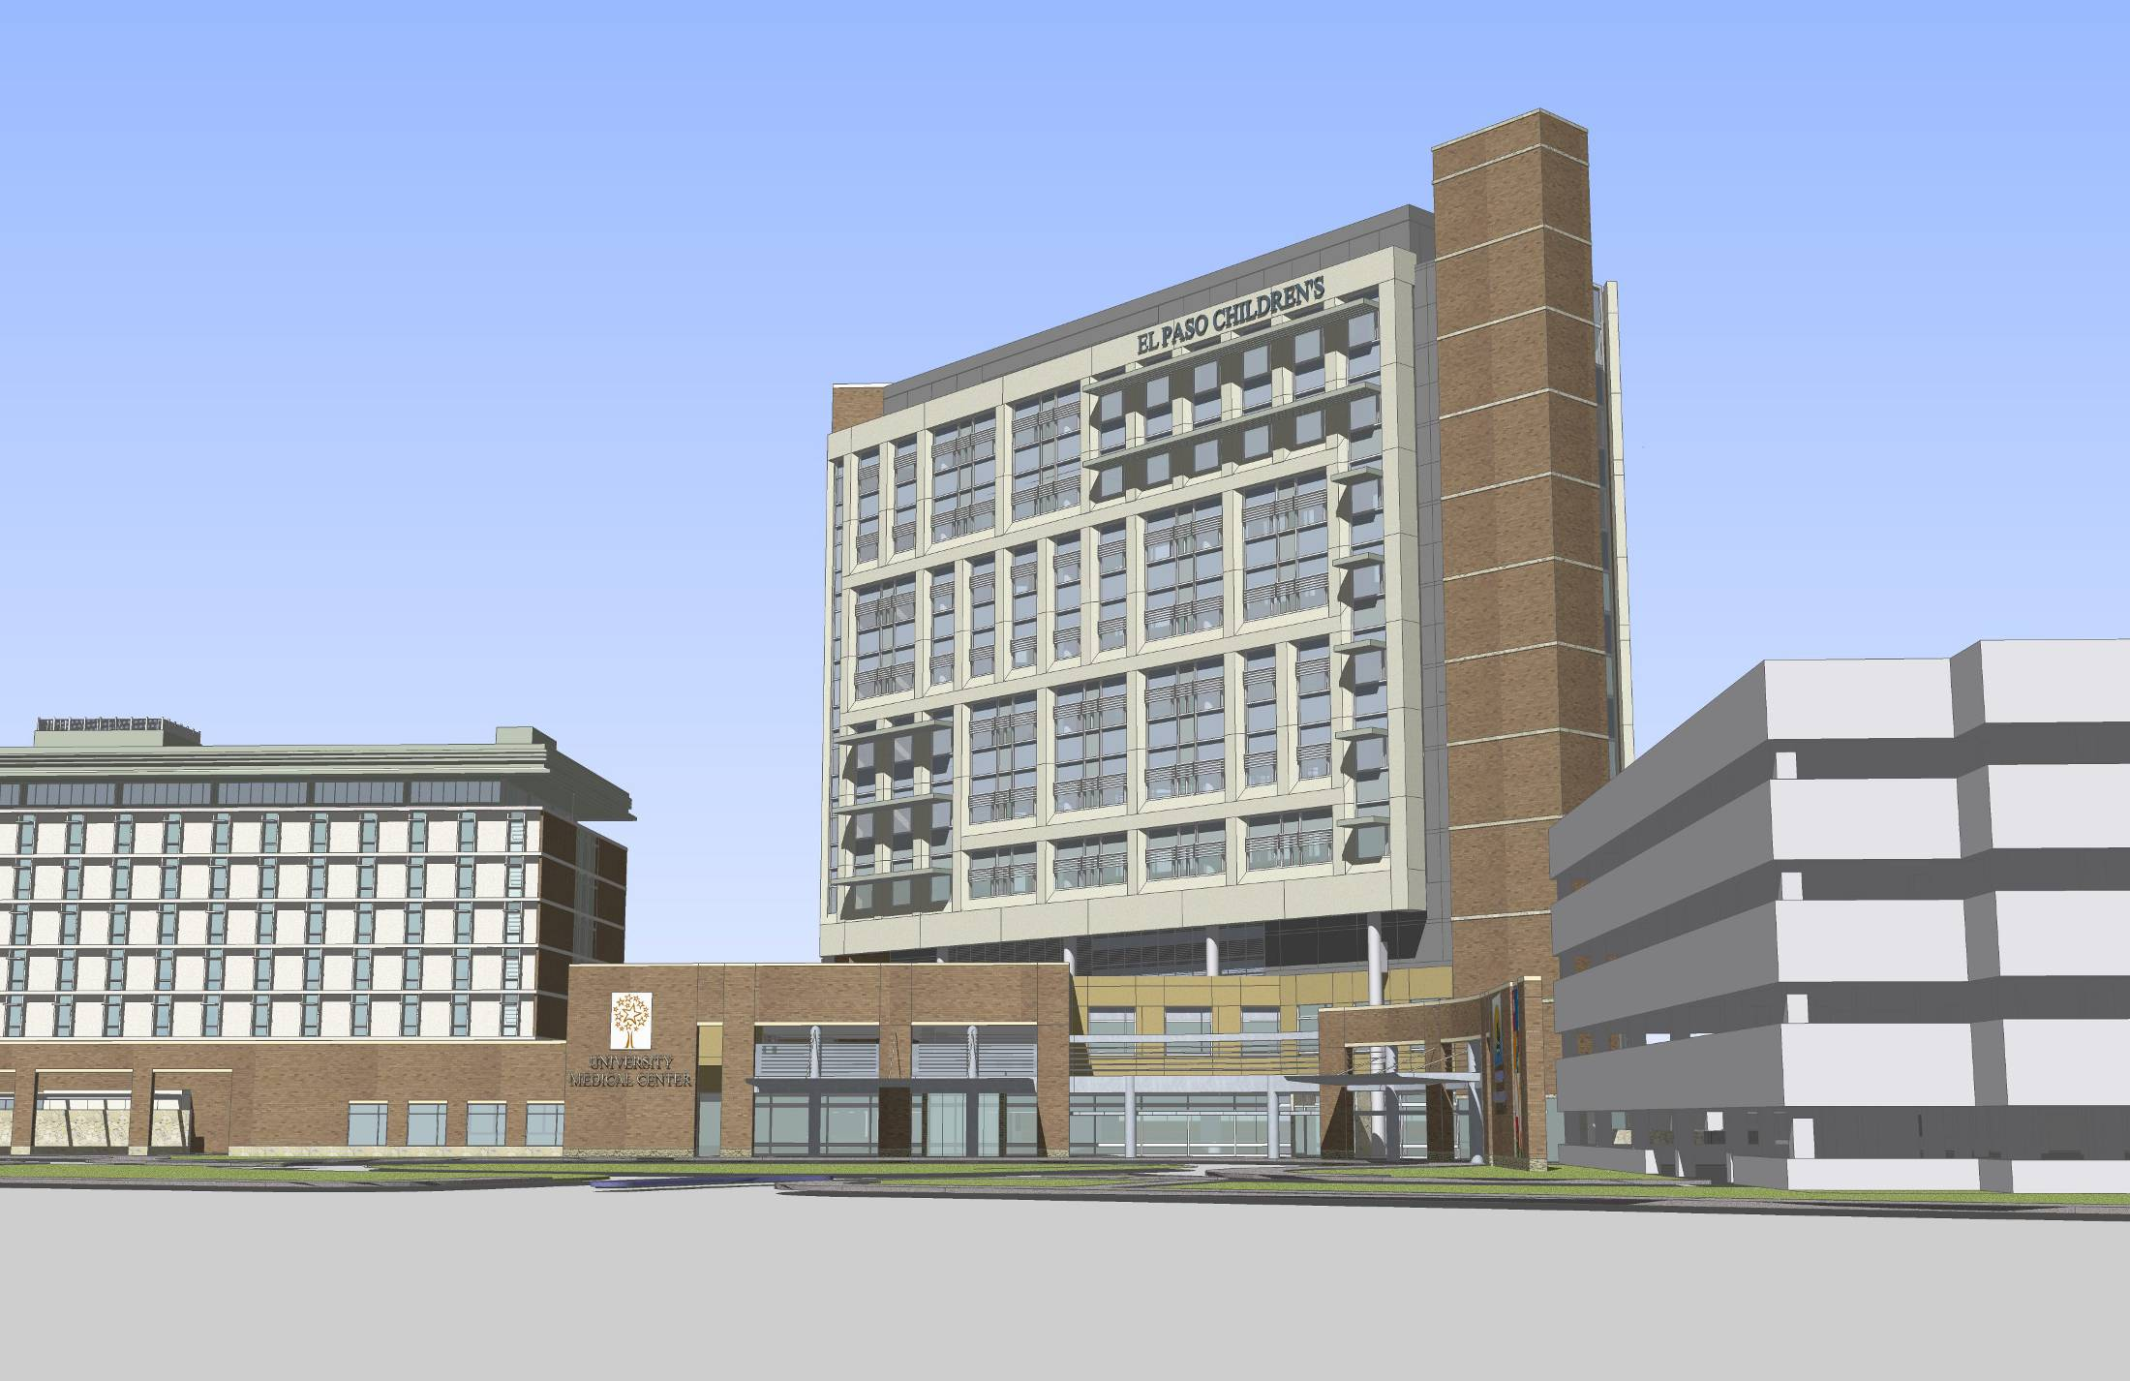
Thank You!

